Slide 1
Instagram User Analytics
Ayush Saxena

Slide 2



Introduction
This is a project about Instagram User analysis in which we will be helping Instagram employees to derive business insights for marketing, product & development by providing the data to them using SQL(Structured Query language), by this thing we can get all answers that the employee asked us to upgrade the Instagram services.

Slide 3
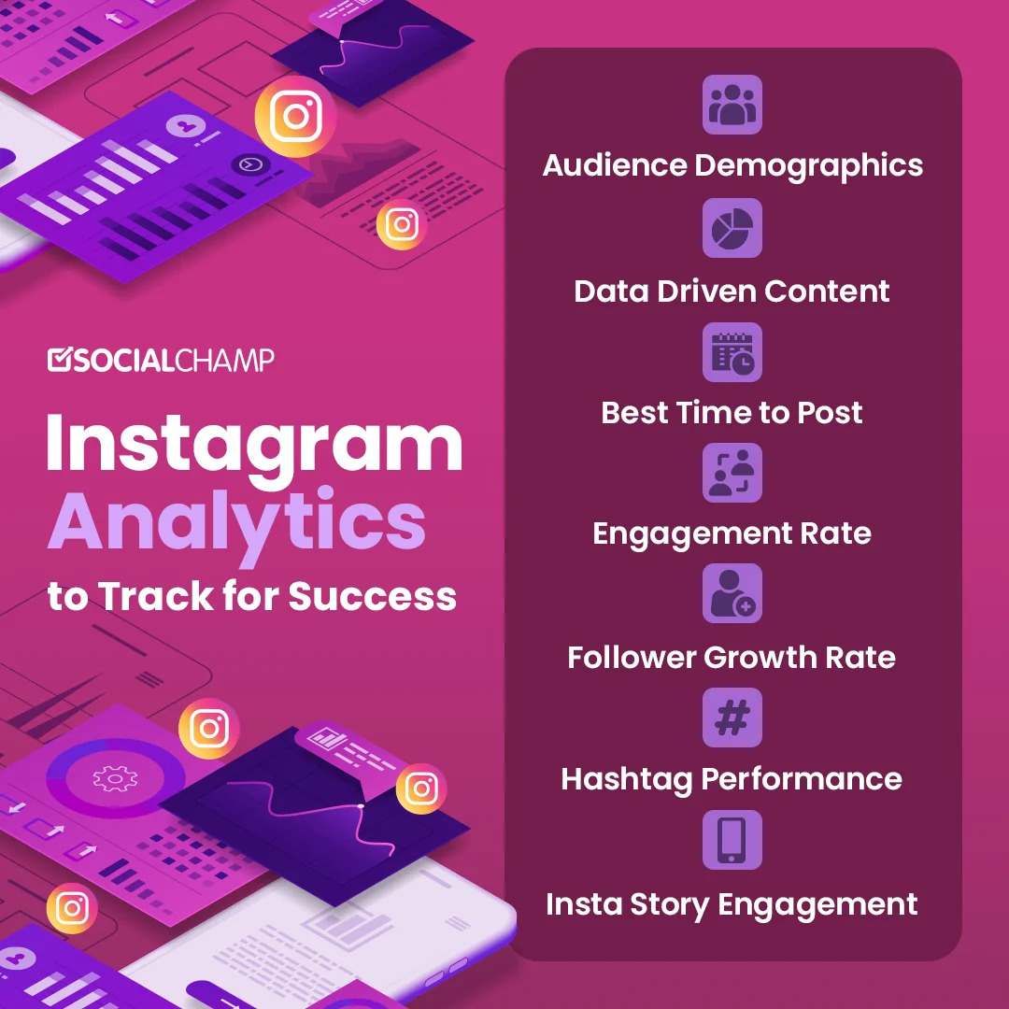
Agenda
Marketing: The marketing team wants to launch some campaigns and needs your help with the following.
Rewarding Most Loyal Users:- Find the 5 oldest users of Instagram from the database provided.
Remind Inactive Users to Start Posting:- Find the users who have never posted a single photo on Instagram.
Declaring Contest Winner:- Identify the winner of the contest and provide their details to the team.
Hashtag Researching:- Identify and suggest the platform's top 5 most commonly used hashtags.
Launch AD Campaign:- What day of the week do most users register on? Provide insights on when to schedule an ad campaign.
Investor Metrics: Our investors want to know if Instagram is performing well and is not becoming redundant like Facebook, they want to assess the app on the following grounds.
User Engagement: Are users still as active and post on Instagram or they are making fewer posts Your Task: Provide how many times does average user posts on Instagram. Also, provide the total number of photos on Instagram/the total number of users.
Bots & Fake Accounts: The investors want to know if the platform is crowded with fake and dummy accounts Your Task: Provide data on users (bots) who have liked every single photo on the site (since any normal user would not be able to do this)

Slide 4
Approach
Firstly, I have gone through the data and then analyze the data which sheet has which type of data, afterward I try to join all the sheets then after that I approach the question in My SQL then extract the insightful data from the raw data and answer the question as asked.
Techstack: MySQL, PowerPoint

Slide 5
Marketing
The marketing team wants to launch some campaigns and needs your help with the following.

Slide 6
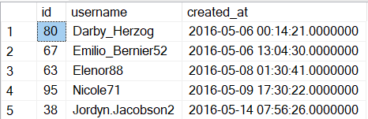
Rewarding Most Loyal Users:- Find the 5 oldest users of Instagram from the database provided.
select top 5 * from users
order by created_at asc;

Slide 7
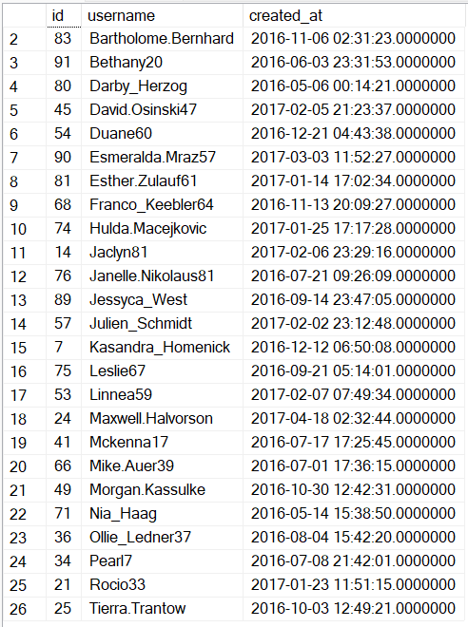
Remind Inactive Users to Start Posting:- Find the users who have never posted a single photo on Instagram.
select z.* from users z
LEFT JOIN photos y ON z.id = y.user_id
WHERE y.user_id is null
order by z.username;

Slide 8

Declaring Contest Winner:- Identify the winner of the contest and provide their details to the team.
Select users.username,count(*) as Total_likes from likesjoin photos on photos.id = likes.photo_idjoin users on users.id = likes.photo_idgroup by photos.idorder by Total_likes desclimit 1;

Slide 9
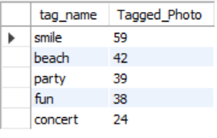
Hashtag Researching:- Identify and suggest the platform's top 5 most commonly used hashtags.
Select tags.tag_name, count(pt.photo_id) as Tagged_Photo from photo_tags ptinner join tags on pt.tag_id = tags.idgroup by tags.tag_nameorder by Tagged_Photo desclimit 5;

Slide 10

Launch AD Campaign:- What day of the week do most users register on? Provide insights on when to schedule an ad campaign.
SELECT DAYNAME(created_at) AS Day, COUNT(*) AS total FROM users GROUP BY Day ORDER BY total DESC limit 2;

Slide 11
Investor Metrics
Our investors want to know if Instagram is performing well and is not becoming redundant like Facebook, they want to assess the app on the following grounds

Slide 12

User Engagement: Are users still as active and post on Instagram or they are making fewer posts Your Task: Provide how many times does average user posts on Instagram. Also, provide the total number of photos on Instagram/the total number of users.
with ste as ( SELECT z.id AS userid, COUNT(y.id)AS photoid FROM users z LEFT JOINphotos y on z.id = y.user_id GROUP BY z.id )SELECT SUM(photoid) AS Total_photos,COUNT(userid) AS Total_Users, SUM(photoid)/COUNT(userid) ASPhotos_User from ste;

Slide 13
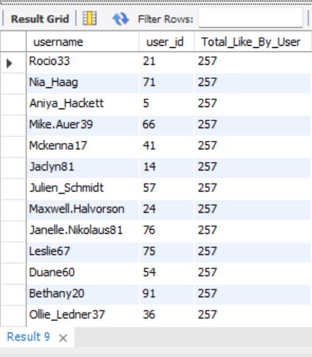
Bots & Fake Accounts: The investors want to know if the platform is crowded with fake and dummy accounts Your Task: Provide data on users (bots) who have liked every single photo on the site (since any normal user would not be able to do this)
Select users.username,likes.user_id,
Count(*) as Total_Like_By_User Fromusers,likesWhere users.id = likes.user_idGroup by user_idOrder by Total_Like_By_User Desc;

Slide 14
The way Instagram is to get started is to quit talking and begin sharing.
Ayush Saxena

Slide 15
Result
As I learned from this project How to import the word data to my SQL before that I have worked with CSV files so it is difficult to recognize how to import it after that I copy the query and then paste it to MySQL and it worked and this project is beyond the level how to approach the question.

Slide 16

Thank you
Ayush Saxena
ayushsaxenamasai@gmail.com
LinkedIn:- ayush9179483904

